Slide 1
Data Center Security
Ang Chen
EECS 388
Nov 21, 2024

Slide 2
Datacenter overview
Nodes: Commodity servers and switches, organized in racks
Performance bottleneck: The network
Search infrastructures – interactive search queries
Big data. MapReduce shuffling (“East-West” traffic)
Service oriented architectures in web services (“North-South” traffic)
Today, network is an even bigger bottleneck:
MapReduce and Spark (distributed data processing), AI training

Slide 3
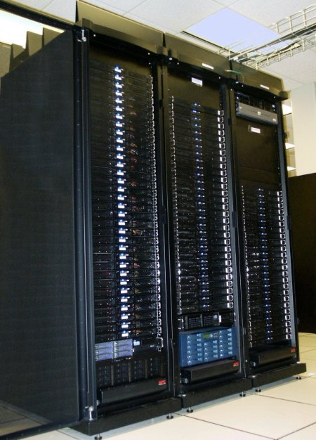
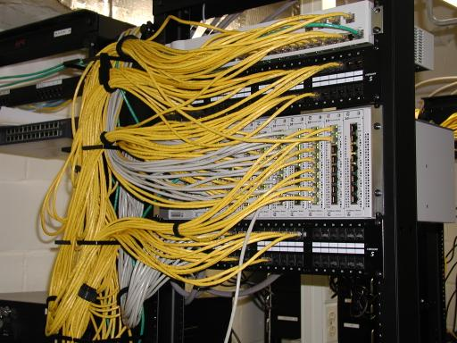
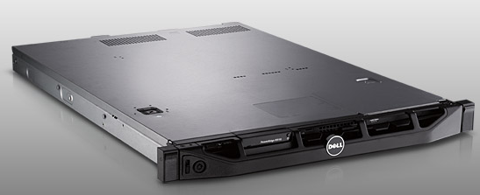
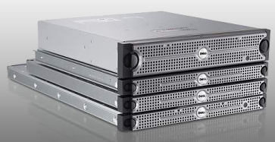
Racks
Network switch (connects nodes with each other and with other racks)
Rack
Many nodes/blades (often identical)
Storage device(s)
Characteristics of a cluster:
Many similar machines, close interconnection
Often standardized hardware (racks, blades)

Slide 4
Key decisions for datacenter design
High bandwidth
Economies of scale
Use commodity parts whenever possible.
Backward TCP/IP compatibility
Use IP and Ethernet whenever possible.
E.g. Infiniband runs its own L1-L4 protocol. (Traditionally used in HPC clusters)
Fault tolerance
Can discover and recover from link failures fast

Slide 5
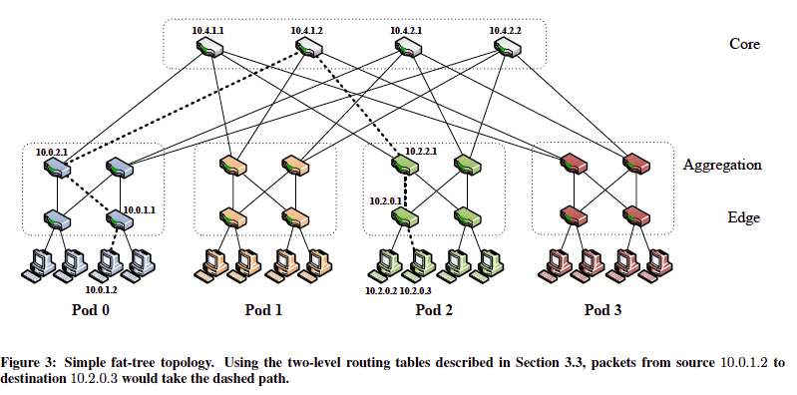
Clos Networks / Fat-Trees
Charles Clos, 1950: Telephony networks

Slide 6
“Fat-Tree” based architecture
K-ary fat tree:
Each pod consists of (k/2)² servers & 2 layers of k/2 k-port switches
Each edge switch connects to k/2 servers & k/2 aggr. switches
Each aggr. switch connects to k/2 edge & k/2 core switches
(k/2)² core switches: each connects to k pods
Addresses: 10.pod.switch.1 (switch), 10.pod.switch.ID (host)

Slide 7





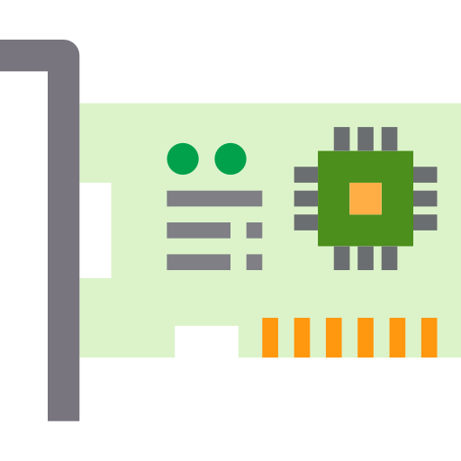


End host: Remote Direct Memory Access
Read
request
Read
request
RNIC
Traditional protocols
RDMA
Ether Header
IP Header
UDP Header
Base Transport Header
RDMA Header
Payload
RDMA over Converged Ethernet v2 (RoCEv2)
Traditional protocols involve software processing on remote CPUs
RDMA enables reading/writing remote memory with CPU bypassing
RNIC (RDMA NIC) performs DMA to application’s memory
Can run over Ethernet with RoCEv2
Has been widely deployed in clouds
Notes:
Consider a scenario where a local application is trying to read some data in remote memory across a network. Traditional protocols, like TCP/IP involve the remote CPU to process the requests. This method consumes CPU cycles and introduces extra latency.
On the other hand, remote direct memory access, or shortly RDMA, enables the local application to read or write remote memory with CPU bypassing.
In other words, this saves the CPU resource for other application usage and avoid extra latency.
The magic happens in the RDMA-enabled NIC or RNIC.
RNIC can process RDMA requests in the hardware and
uses DMA to operate on the application’s memory without involving CPU.
As the demand on high performance network increases, RDMA protocols such as RoCEv2, are proposed to support RDMA on a converged ethernet.
And because of its easy deployment, today’s cloud vendors have deployed RDMA in their data centers.

Slide 8
RDMA for security
Notes:
Hello everyone, Today I would like to introduce our recent work, remote direct memory introspection. This is a joint work from Rice University, MIT and Duke university.

Slide 9


Target problem: memory introspection
Dom0
Guest machine
rootkit
Modified memory
Hypervisor
Memory introspection is a critical security task.

Slide 10



Target problem: memory introspection
Dom0
Memory forensic
Guest machine
Modified memory
Hypervisor
LibVMI
pslist
cred_ck
modlist
vfs_ck
Memory introspection is a critical security task.
It can detect attackers even with a compromised OS(i.e. rootkit attacks).
Agent snapshots raw memory for further forensics.
Hypervisor-based introspection is the most common.
Livewire(NDSS’03), ImEE (SEC’17), LibVMI.

Slide 11
Limitations of hypervisor-based forensics
Dom0
Local interference
Guest machine
Modified memory
Hypervisor
Large trusted computing base
Poor baremetal installation support
Hypervisor based introspection has inherent limitations
Can network devices help?

Slide 12
Insight: Security offloading
Dom0
Memory forensic
Guest machine
Modified memory
Memory forensic
Hypervisor
Hardware
Dom(-1)
Can we solve the problem by moving one layer below?
Enforce security in network hardware
Support efficient and baremetal execution.

Slide 13

RDMA provides an unique opportunity
Read
request
RNIC
RDMA
Ether
IPv4
UDP
Base Transport Header
RDMA Header
…
RoCEv2 packet format
RDMA stands for remote direct memory access.
RDMA enables reading/writing remote memory with CPU bypass.
RNIC (RDMA NIC) performs DMA to remote memory.
RDMA can run over Ethernet with RoCEv2 protocol.
RDMA been widely deployed in cloud datacenters
RDMA can serve as memory datapath for Dom(-1) introspection.

Slide 14

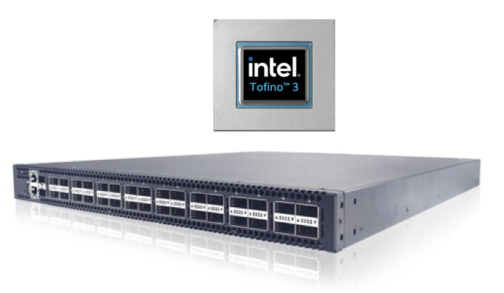
.. Driven by programmable switches
table compute_NxtPC_tab {
key = {
rdma.qpn: exact;
meta.pred: exact;
}
actions = {compute_NxtPC;}
}
Programmed with high-level language, e.g., P4.
Parse RDMA headers, match-action tables and stateful operations.
Run at line rate speed (Tbps)
Have been widely used to build security defenses:
PortCatcher-CCS’22, IMAP-NSDI’22, Bedrock-Security’22, etc.
Programmable switches are commercially available.
Programmable switch can enforce control logic efficiently.

Slide 15
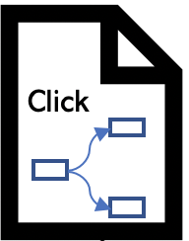








RDMI: Remote Direct Memory Introspection
BMaaS
.DSL
Reconfig
Deploy
RDMI DSL
RNIC
…
Programmable switch
RDMI Runtime
RDMI compiler
Baremetal support
Remote execution
Programmable
Efficient introspection
COTS deployment
DSL support eliminates low level programming burdens.
RDMI: A new paradigm for memory introspection.

Slide 16


Outline
Motivation: Better memory introspection
- Opportunity: Dom(-1) security execution
Approach: Remote Direct Memory Introspection
RDMI design:
Design #1: DSL design for introspection
Design #2: Abstract introspection machine
Design #3: Reconfigurable introspection engines
Evaluation
Conclusion

Slide 17

RDMI DSL primitives
task_struct
pid: 0
*mm
init_task
0xffffabcd
mm_struct
*nxt_task
vm_area_struct:
vm_start: **
Vm_end: **
task_struct
pid: 1
*nxt_task
task_struct
file
struct task_struct {
int pid;
struct task_struct *nxt_task;
struct mm_struct *mm;
};
…
Follow nxt_task and get me each PID!
Memory introspection share similar patterns with graph processing.

Slide 18

RDMI DSL primitives
task_struct
pid: 0
*mm
init_task
0xffffabcd
mm_struct
Operators | Descriptions
kgraph(addr) | Initialize traversal at addr
*nxt_task
vm_area_struct:
vm_start: **
Vm_end: **
task_struct
pid: 1
*nxt_task
task_struct
file
struct task_struct {
int pid;
struct task_struct *nxt_task;
struct mm_struct *mm;
};
…
Follow nxt_task and get me each PID!
Gremlin Lang
Memory introspection shares similar patterns with graph processing.

Slide 19
RDMI DSL primitives
task_struct
pid: 0
*mm
init_task
0xffffabcd
mm_struct
Operators | Descriptions
kgraph(addr) | Initialize traversal at addr
in(ptr) | Dereference ptr into another object
*nxt_task
vm_area_struct:
vm_start: **
Vm_end: **
task_struct
pid: 1
*nxt_task
task_struct
file
struct task_struct {
int pid;
struct task_struct *nxt_task;
struct mm_struct *mm;
};
…
Follow nxt_task and get me each PID!
Gremlin Lang
Memory introspection share similar patterns with graph processing.

Slide 20
RDMI DSL primitives
task_struct
pid: 0
*mm
init_task
0xffffabcd
mm_struct
Operators | Descriptions
kgraph(addr) | Initialize traversal at addr
in(ptr) | Dereference ptr into another DS
traverse(ptr_nxt, ptr_end, type) | Traverse ptr_nxt until ptr_end with type
*nxt_task
vm_area_struct:
vm_start: **
Vm_end: **
task_struct
pid: 1
*nxt_task
task_struct
file
struct task_struct {
int pid;
struct task_struct *nxt_task;
struct mm_struct *mm;
};
…
Follow nxt_task and get me each PID!
Gremlin Lang
Memory introspection share similar patterns with graph processing.

Slide 21
RDMI DSL primitives
task_struct
pid: 0
*mm
init_task
0xffffabcd
mm_struct
Operators | Descriptions
kgraph(addr) | Initialize traversal at addr
in(ptr) | Dereference ptr into another DS
traverse(ptr_nxt, ptr_end, type) | Traverse ptr_nxt until ptr_end with type
values(f1, …, fn) | Acquire values from current address
… | …
*nxt_task
vm_area_struct:
vm_start: **
Vm_end: **
task_struct
pid: 1
*nxt_task
task_struct
file
struct task_struct {
int pid;
struct task_struct *nxt_task;
struct mm_struct *mm;
};
…
Follow nxt_task and get me each PID!
Gremlin Lang
Memory introspection share similar patterns with graph processing.

Slide 22
RDMI introspection queries
init_task
task_struct
pid=0
kgraph(init_task)
.traverse(tasks.next, &init_task.tasks, task_struct)
.values(pid)
tasks.next
task_struct
pid=1
Sample query: task_list traversal
tasks.next
task_struct
pid=5
…
tasks.next
task_struct
pid=13426

Slide 23
RDMI introspection queries
init_task
task_struct
pid=0
kgraph(init_task)
.traverse(tasks.next, &init_task.tasks, task_struct)
.values(pid)
tasks.next
task_struct
pid=1
Sample query: task_list traversal
tasks.next
task_struct
pid=5
…
tasks.next
task_struct
pid=13426

Slide 24
RDMI introspection queries
init_task
task_struct
pid=0
kgraph(init_task)
.traverse(tasks.next, &init_task.tasks, task_struct)
.values(pid)
tasks.next
task_struct
pid=1
Sample query: task_list traversal
tasks.next
task_struct
pid=5
…
tasks.next
task_struct
pid=13426

Slide 25
RDMI introspection queries
init_task
task_struct
pid=0
kgraph(init_task)
.traverse(tasks.next, &init_task.tasks, task_struct)
.values(pid)
tasks.next
task_struct
pid=1
Sample query: task_list traversal
tasks.next
task_struct
pid=5
…
tasks.next
task_struct
pid=13426

Slide 26
RDMI introspection queries
init_task
task_struct
pid=0
kgraph(init_task)
.traverse(tasks.next, &init_task.tasks, task_struct)
.values(pid)
tasks.next
task_struct
pid=1
Sample query: task_list traversal
tasks.next
task_struct
pid=5
…
tasks.next
task_struct
pid=13426

Slide 27
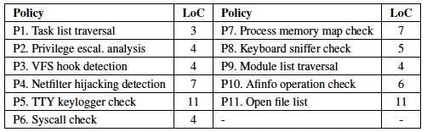
RDMI introspection queries
init_task
task_struct
pid=0
kgraph(init_task)
.traverse(tasks.next, &init_task.tasks, task_struct)
.values(pid)
tasks.next
task_struct
pid=1
Sample query: task_list traversal
tasks.next
task_struct
pid=5
…
tasks.next
task_struct
pid=13426
RDMI DSL can express a range of common introspection queries.

Slide 28
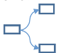

DSL compilation: naïve solution
.DSL
.DSL
.DSL
compile
Deploying policy incurs downtime.
Resource sharing across policies is difficult

Slide 29


Abstract introspection machine
.C
.ASM
compile
execute
.DSL
.DSL
.AIM
Backend
compile
.conf
Frontend
compile
config
.DSL
Mov, Push, Pop, etc.
AIM instr. are shared implementation across DSL primitives.
AIM is further compiled config MAT inside switch reconfigurable engines.

Slide 30


Reconfigurable introspection engines
Endianess engine
table NxtPC_tab {
key = {
rdma.qpn: exact;
meta.pred: exact;
}
actions = {compute_NxtPC;}
}
AIM engine
.conf
Config
Address trans. engine
TABLE | rdma.qpn | meta.pred | param
NxtPC_tab | 7 | 0 | 8
NxtPC_tab | 8 | 0 | 9
NxtPC_tab | 8 | 1 | 10
…
…
Match action tables(MAT)
Reconfigurable engine sets
Reconfigurable introspection engines instantiate the AIM instructions.
MAT are configured and encoded with AIM logic.

Slide 31
Experiment setup
RDMI prototype:
Runs with Tofino Wedge 100BF-32X switch and Mellanox CX-4 NIC.
2500 LoC of P4 + 2700 LoC of C++.
Baseline:
LibVMI based introspection.
Software emulated RDMI.
Real world applications:
Redis and Nginx workloads.

Slide 32
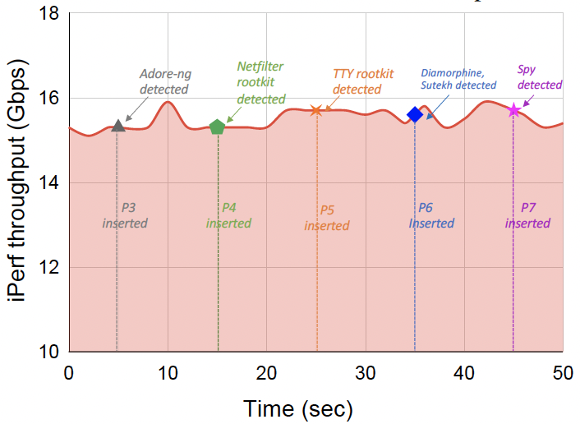
Evaluation: introspection effectiveness
RDMI effectively detects the real world rootkits.
RDMI’s policy deployment won’t affect normal traffics.

Slide 33
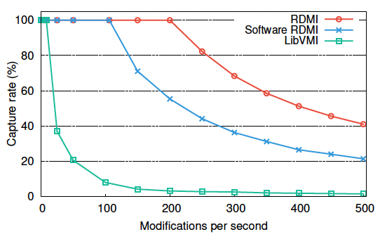
Evaluation: introspection speed
RDMI’s higher introspection frequency leads to larger capture rate.

Slide 34
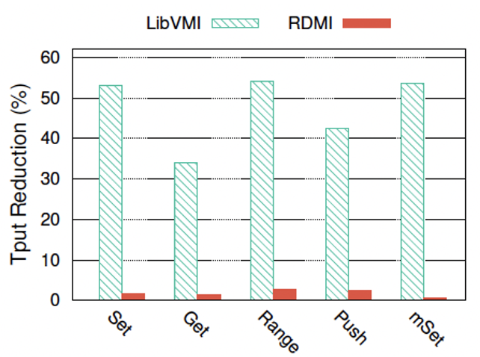
Evaluation: workload interference
RDMI’s interference to guest workload is negligible.

Slide 35
Conclusions
Motivation: Better memory introspection.
Insight: Dom(-1) security offloading.
Supported by widely-deployed hardware.
RDMI: Remote direct memory introspection.
DSL support for introspection queries.
Compiler for converting DSL into low-level instr.
Runtime for supporting executions.
Source code: https://github.com/aladinggit/RDMI/

Slide 36
Securing RDMA

Slide 37
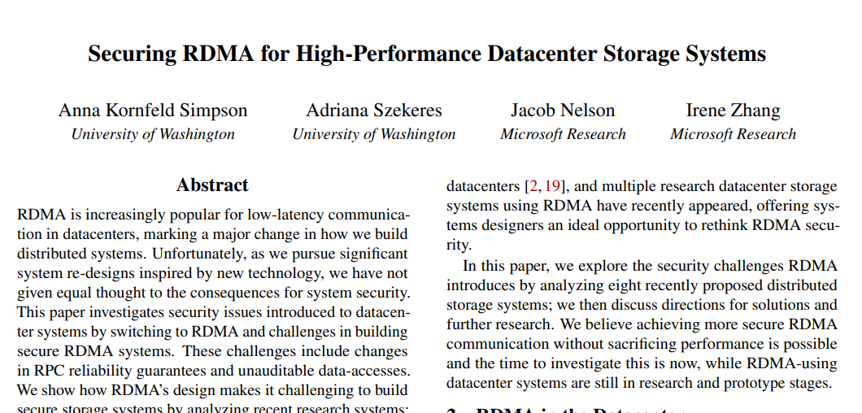
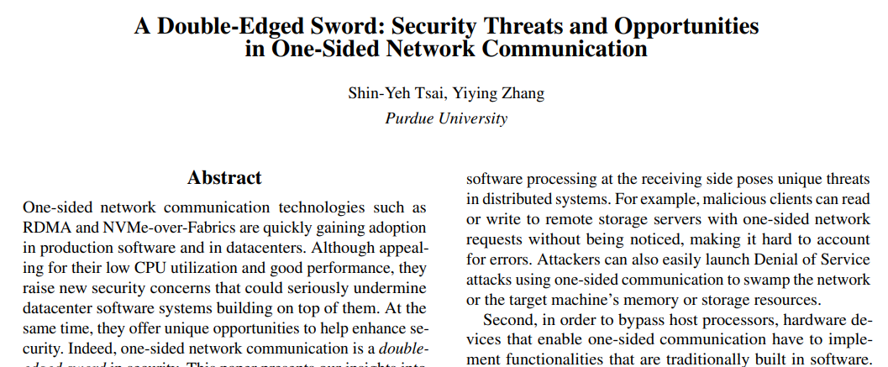
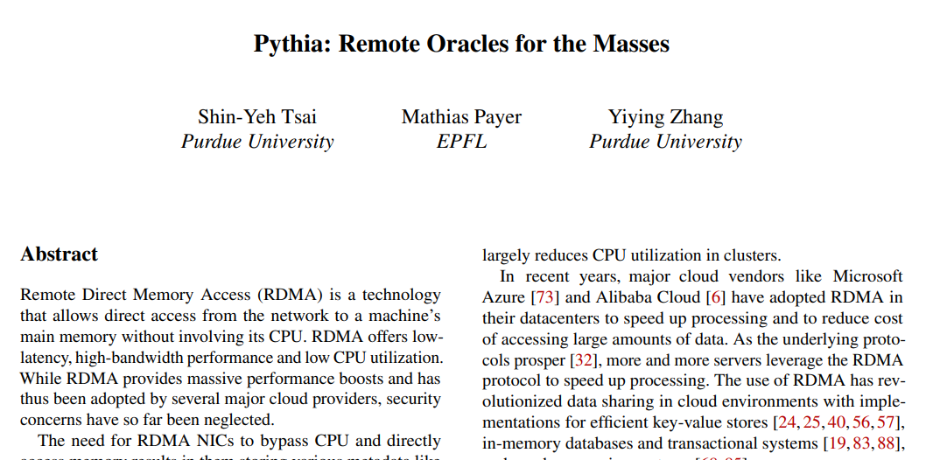
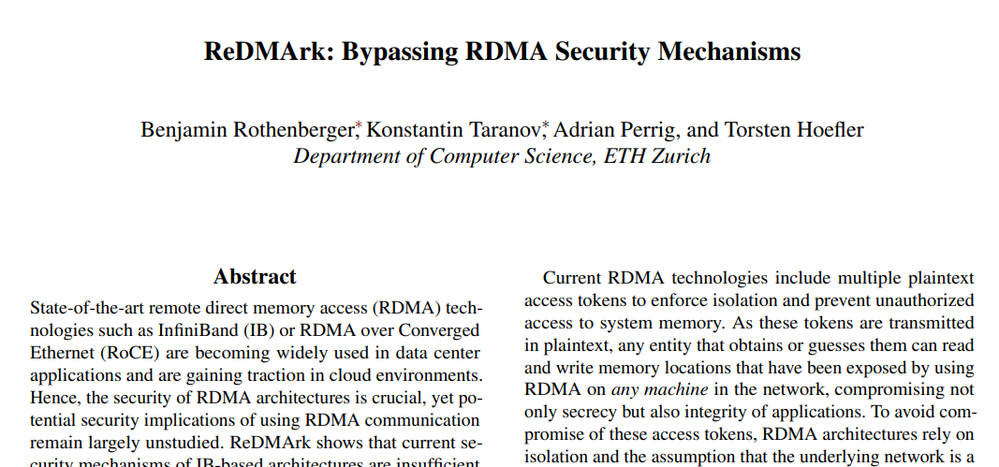
Motivation: RDMA is insecure
Inadequate security feature | # | Attack type | Attack method
Source authentication | S1 | Illegal memory access | QP spoof
 | S2 | Illegal memory access | Packet injection
 | S3 | Denial of service | Seq number error
 | S4 | Denial of service | QP error
Access control | S5 | Illegal memory access | Access control bypass
Monitoring and logging | S6 | Denial of service | QP exhaustion
 | S7 | Perf. degradation | BW exhaustion
 | S8 | Side channel | Evict + Reload
 | S9 | Data exfiltration | RDMA read
RDMA is designed for private usage with minimal security support
Designed for HPC in private clusters; widely deployed in public clouds now
Recent studies have revealed lots of vulnerabilities

Slide 38
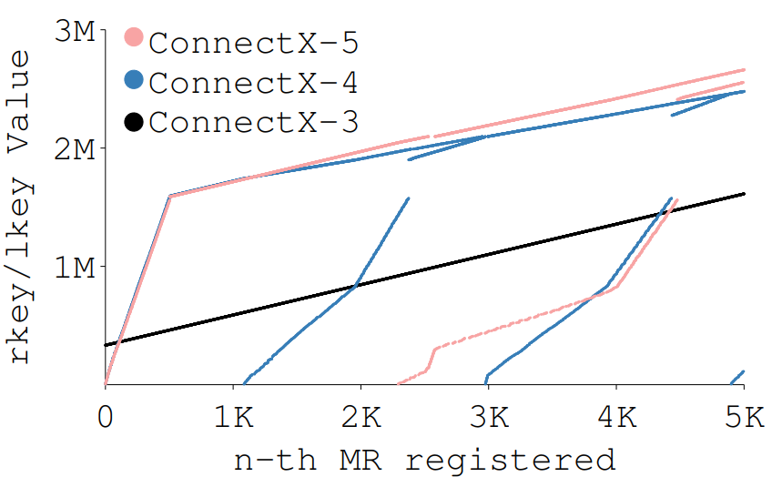
Insufficient RDMA-native security support
RDMA security mechanisms
Queue pair number (QPN)
Remote memory access key (rKey)
Packet sequence number (PSN)
Vulnerabilities
Not randomly generated
Length
24 bits
32 bits
24 bits
Not randomly generated
Fixed initial values
rKey value generated by RNICs [1]
RDMA is unencrypted; uses simple credentials (e.g., QPN, rKey)
QPN and rKey are not randomly generated
PSN has fixed initial values
Easy to enumerate all possible values
[1] Tsai, Shin-Yeh, and Yiying Zhang. "A Double-Edged Sword: Security Threats and Opportunities in One-Sided Network Communication." (HotCloud 19).

Slide 39


Example: Illegal memory access
0x7ff1234
RDMA
Victim client
10.0.0.1
Owner=V
QPN = 111
rKey=0x100
0x7ff2345
Owner=M
QPN = 222
rKey=0x200
RDMA
Malicious client
10.0.0.2
IP=10.0.0.1
QPN=111
rKey=0x100
0x7ff3456
RDMA server
An attacker can access memory owned by others by guessing credentials

Slide 40


Challenges of end host solutions
Redesign RDMA protocol and RNIC
Read
request
RNIC
Requires intrusive changes of existing RDMA systems
Software security patch on CPUs
Negates the benefit of CPU bypassing
Read
request

Slide 41




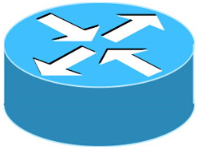
Bedrock: RDMA security support in the network
…
Bedrock
Bedrock provides RDMA security support in the network
A platform with several security services
Can be extended to support more security defenses
Preserves CPU bypassing on the hosts
Can be deployed immediately

Slide 42
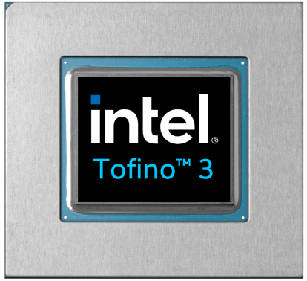
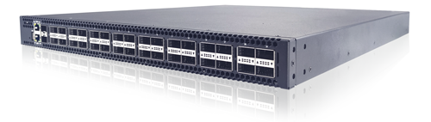
Key enabler: Programmable switches
table rdma_log_tab {
key = {
rdma.qpn: exact;
rdma.addr: range;
rdma.op: exact;
}
actions = {Log; DoNothing;}
}
Programmable switches are commercially available
Programmed with high-level language, e.g., P4
RDMA header parser, match-action tables, registers, ...
Run at linespeed (Tbps)
Have been widely used to build security defenses for traditional protocols:
Jaqen-Security’21, FlowLens-NDSS’21, Ripple-Security’21, etc.
We use it to provide security support for RDMA.

Slide 43
Source authentication using network invariants
Src IP | Incoming port | Action
10.0.0.1 | 1 | accept
10.0.0.2 | 2 | accept
… |  | …
default |  | drop
10.0.0.1
Port 1
0x7ff1234
Owner=V
rKey=0x100
Pkt with 10.0.0.1
0x7ff2345
Owner=M
rKey=0x200
Port 2
10.0.0.2
0x7ff3456
Programmable switch
Key idea: Using topological invariants beyond attackers’ control
Cloud network is trusted; network operators control the invariants (e.g., incoming port)
Spoofed packets coming from wrong topological location will be dropped

Slide 44


In-switch access control for RDMA
start_addr
0x7ff0000
table rdma_acl_tab {
key = {
rdma.s_addr: range;
rdma.e_addr: range;
rdma.op: exact;
}
actions = {Allow; Deny;}
}
read
Read-only
read
write
ACL table on the switch
0x7ffffff
Allocated memory
end_addr
Ensure requests accessing the memory correctly
Determine containing relationship of two ranges

Slide 45
Regain visibility by monitoring and logging
Monitoring:
On-path traffic monitoring to detect anomaly
Logging:
Extract key info to logging servers for forensics

Slide 46
Bedrock defends against nine attacks
Inadequate security feature | # | Attack type | Attack method
Source authentication | S1 | Illegal memory access | QP spoof
 | S2 | Illegal memory access | Packet injection
 | S3 | Denial of service | Seq number error
 | S4 | Denial of service | QP error
Access control | S5 | Illegal memory access | Access control bypass
Monitoring and logging | S6 | Denial of service | QP exhaustion
 | S7 | Perf. degradation | BW exhaustion
 | S8 | Side channel | Evict + Reload
 | S9 | Data exfiltration | RDMA read
✓
Experimental testbed:
NIC on all machines: Mellanox ConnectX-4 MT27710 25Gbps (with RoCEv2)
Switch: Wedge 100BF-32X Tofino switch

Slide 47
Access control rule compression
30
With Opt.
16
With Opt.
25
Without Opt.
14
Without Opt.
12
20
10
The Higher the better
Supported #rules (*1000)
Supported #rules (*1000)
The Higher the better
15
8
6
10
4
5
2
0
0
1
1.2
1.4
1.6
1.8
2
Twitter
Idiada
Arctur
Skewness of Zipf’s law
Workload
Need to enhance security despite limited resource
Naïve implementation without optimization only supports 5000 ACL rules
Bedrock’s optimizations increase ACL rules by 7x

Slide 48
Resource usage
Feature | SRAM | TCAM | Hash bits | Meter ALU
Auth.
ACL
Mon.
Log.
4.17 % | 2.08 % | 2.48 % | 0 %
10.52 % | 68.75 % | 27.78 % | 0 %
26.56 % | 7.64 % | 16.39 % | 27.08 %
12.29 % | 11.46 % | 12.22 % | 68.75 %
Authentication does not cost much switch resource
ACL costs more on TCAM for matching ranges of addresses
Monitoring and Logging costs Meter ALU which is for saving stats

Slide 49
Summary
Motivation: Mitigating RDMA vulnerabilities
Opportunity: Programmable switches
Complement the missing on-path defense for RDMA
Bedrock: In-network RDMA security suite
Support authentication, access control, monitoring, logging
Effective against attacks
Immediately deployable
Extensible against future attacks
Evaluation:
Mitigates nine RDMA attacks effectively with minimal perf. overhead!
Source code: https://github.com/alex1230608/Bedrock

